Slide 1
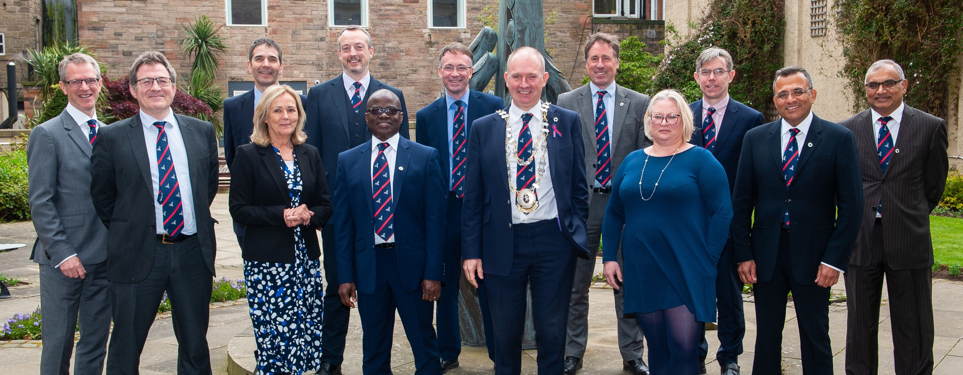
Annual General Meeting 2022

Slide 2
30th Anniversary

Slide 3
Apologies for absence Donald Adam Neeraj Bhasin Lucy Wales Minutes of the AGM 2021 Matters arising from the minutes President

Slide 4
Honorary Secretary
Achievements
First year NCIAs
Parental leave policy
Elections and Appointments
Job planning
Update MOU with RC of Podiatry
Outstanding
New website
Member engagement
With thanks,
Sophie Renton
Officers and Council
Louise and the whole EBS team

Slide 5
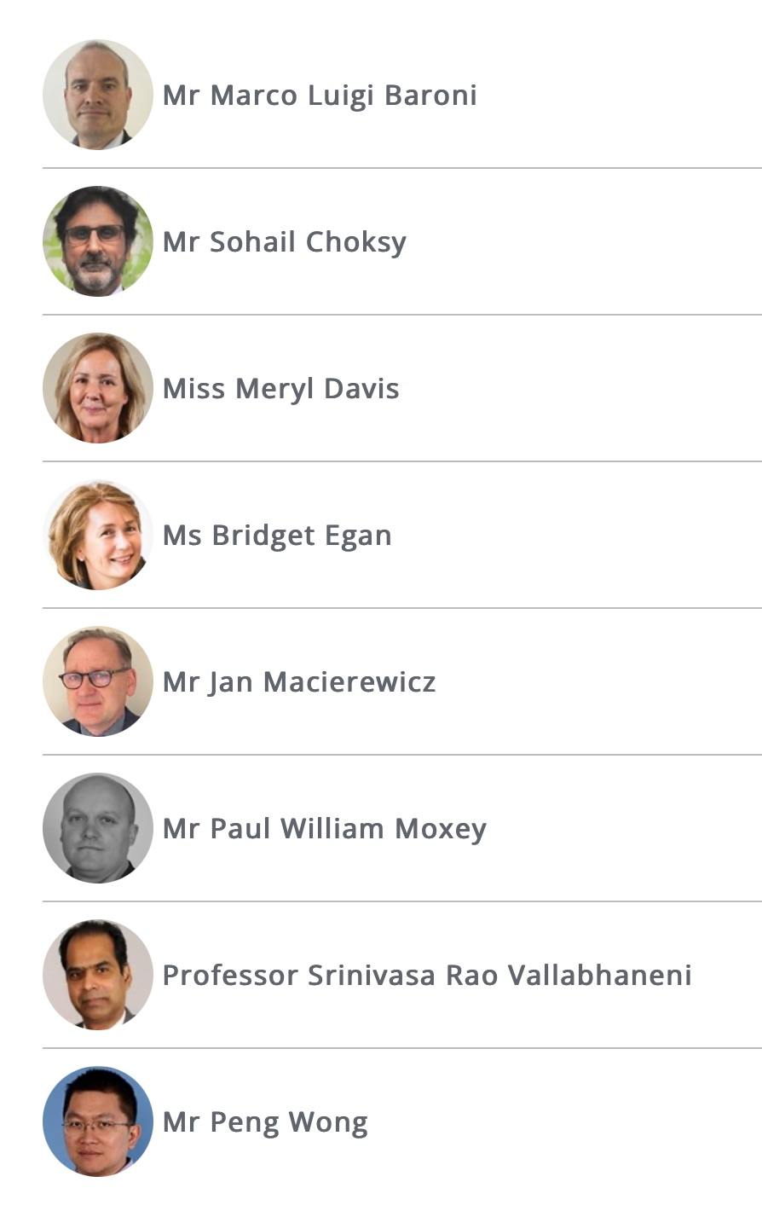
Results of Voting
New Council Members (2022-2025)
1 Meryl Davis
2 Bridget Egan
3 Prof Rao Vallabhaneni
President Elect (2024-5)
Prof Ian Chetter

Slide 6
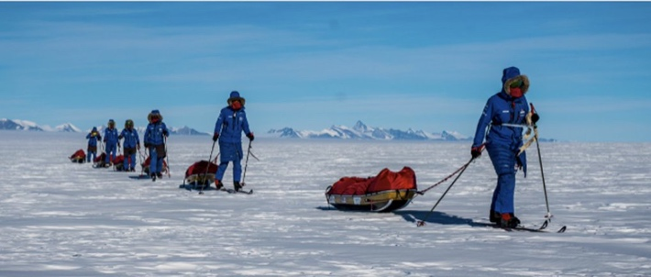
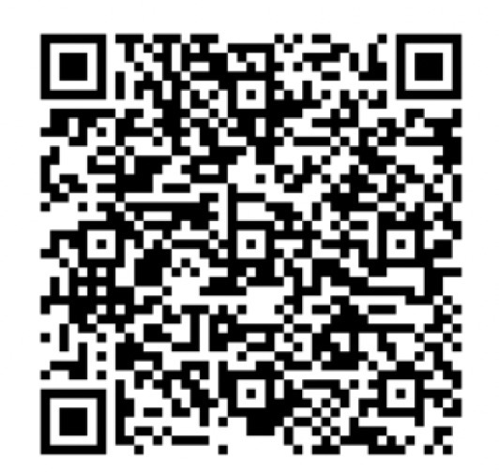
Other changes on your Council
New Committee Chairs
From close 2022 ASM
Research Matt Bown
Education and Training Paddy Coughlin
Circulation Foundation Neeraj Bhasin
From close 2023 ASM
Safety and QI Denis Harkin
Professional Standards Chris Imray
Demitting Council Members
Jon Boyle
Keith Jones
Donald Adam
Chris Imray
Raising for Circulation Foundation
£1,837 of £5,000 raised
@chrisimray
@Antarctic_Inspire_22

Slide 7
Your executive team for 2022/23
Elected Council
President Rachel Bell
Vice-President Andrew Garnham
President Elect Prof Ian Chetter
Honorary Secretary Marcus Brooks
Honorary Treasurer Alistair McCleery
Committee Chairs See below
Elected members Lucy Wales, Kaji Sritharan,* Sadasivam Selvakumar, Ian Hunter and Ansy Egun
Open Council
Elected council members and Officers
SAC representative Ginny Bowbrick
RCS Eng. representative Rob Sayers
Affiliated Societies:
BACPAR, BSIR, Rouleaux Club, SVN and SVTGBI.
Updated MOU with RCPod to be signed this week.
Eight committees **
* Took maternity leave 2021-22
Executive
All Officers
Professional Standards
Ian
Loftus
Education & Training
Patrick Coughlin
Research
Matt
Bown
Audit and Quality Improvement
Arun
Pherwani
Workforce
Ciaran McDonnell
ASM
Douglas
Orr
Circulation
Foundation
Neeraj
Bhasin

Slide 8
What YOU can do for the Society
Tell us what you want from the Society and how we can help you
Stand for Council to help with our work
Support the work of the Circulation Foundation
E-mail : president@vascularsociety.org.uk
or secretary@vascularsociety.org.uk
Or speak to any council member
The Vascular Society of Great Britain & Ireland c/o Executive Business Support Ltd City Wharf, Davidson Road, Lichfield, Staffordshire WS14 9DZ 02072057150
admin@vascularsociety.org.uk

Slide 9
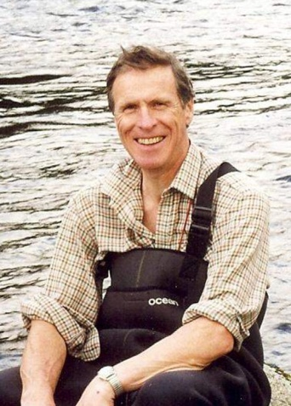
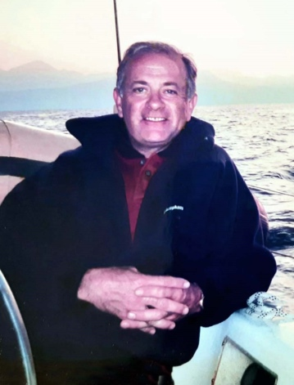
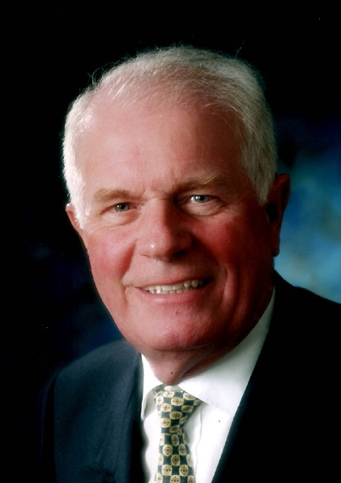
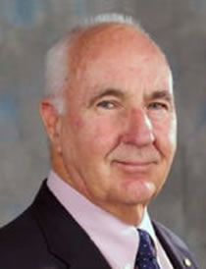
In Memoriam
L
Lady Anne Bell
Wife of Sir Peter Bell
Kok-tee Khaw
Wife of Peter Taylor
Andrew (Sandy) McLaren Jenkins
February 2022
Consultant in Edinburgh
Steve Jones
April 2022
Consultant in Taunton
John (Ian) Millie Dow Galloway
August 2022
Consultant in Hull
Past President VS
Sir Peter Morris
October 2022
Consultant in Oxford
Past RCS Eng President Fellow of Royal Society

Slide 10
Annual Report 2021/2022
Paddy McCleary
Honorary Treasurer

Slide 11
Organisation
Single charitable company limited by guarantee
Charity number 1102769
Vascular Society
CIRCULATION FOUNDATION (Working name)
VSSGBI LTD - limited company to run the ASM
Accounting year: 1/7/21 to 30/6/22

Slide 12
Income and Expenditure 2021/2022
Income
Member subscriptions £ 111 000
ASM 2021 £ 45 000
CF Members donations £ 30 000
CF Public donations £ 111 000
CF Fundraising £ 45 000
Aspire Grants HEE £ 125 000
Industry £ 28 000
Total £ 495 000
Expenditure
Aspire (£ 85 000)
Grants (£ 100 000)
Journal (£ 40 000)
Admin (£ 150 000)
Total (£ 375 000)
Surplus £ 120 000

Slide 13
Society Funds - reserves as of June 2022
CAF Bank £ 750 000
Rathbones £ 433 000 ( - 15%)
Total £ 1 183 000
Restricted funds
Venous Forum £ 11 750
HEE £ 300 000

Slide 14
VS Commitments 2022/23
Research Fellowship Grants
RCS Eng. x 2 £70 000
RCS Ed. x 1 £35 000
RCP&S Glasg. x 1 £35 000
Clinical Fellowship Grants
Aortic Fellowship £35 000
Other funded activity
RCS Eng. SSLs x3 £22 500
ASPIRE £85 000
JVSGBI £20 000
Website update £70 000

Slide 15
Membership and Subscriptions
Membership numbers (Oct 2022)
Ordinary 380 Consultant
Associate 24 Non-Consultant / SAS
Affiliate 109 Trainee NTN or Non-NTN
Overseas 12
Senior 41 Retired
Honorary 34
Membership fees can be suspended for periods of parental leave (introduced 2022)
Subscription rates 2022/23
Ordinary £ 250
Associate £ 140
Affiliate £ 115
Overseas £ 115
Senior £ 45
Honorary N/A
Donation preference (Ordinary members)
A regular donation of £50.00 to the CF, the UKs only dedicated vascular charity, will be automatically added to your membership price.

Slide 16
Education and Training
Achievements
ASPIRE Courses
ASPIRE Digital
Research Fellows
Amputation and Cadaveric courses
Egyptian vascular society meeting
Outstanding
Centralised ASPIRE funding
Simulation
Textbook for medical students
With thanks,

Slide 17
Non-Consultant Grade
Achievements
Survey of SAS doctors
Session at ASM - Friday morning
RCS England SAS Education committee
Outstanding
Workforce challenges
The SAS surgeon’s role
Identifying SAS surgeons
BUH Work
With thanks,
Tatiana Martin

Slide 18
Research
Achievements
Nine SIGs
National research network
Fellows
Journal of the Vascular Societies of Great Britain and Ireland
Outstanding
Vascular Research Network Website
ASPIRE Academic
With thanks,
Nine vascular SIGs

Slide 20
Audit and Quality Improvement
Achievements
NHS England CLTI-CQUIN
QI Research Fellowships
NVR procurement
Aortic device data capture
Annual report (launched at this meeting)
Outstanding
CLTI-CQUIN data collection
International collaboration (VASCUNET)
Introduction of NCIPs
With thanks,
National Vascular Registry team
Allied Societies
Penny Birmpili and Ellie Atkins

Slide 21
Resolution 1: Adoption of the Annual Report and Financial statements 2021/22
Discussion
Vote

Slide 22
Resolution 2: Vote for election of the President by Ordinary Members
Discussion
Vote
Rational for change in Jon Boyle’s Yearbook 2022 entry
RCS England Baroness Kennedy Report recommendations:
1. Reform Elections for Presidency. The Council should present a slate of potential candidates to whole Membership and then voted upon.
3. Reform Council. There should be three tiers; those entering surgery – four/six years; those at mid/senior level – (this cohort should be the largest in number) and those in senior years of practice or retired.

Slide 23
President Elect The Society’s plans for 2022/23

